Slide 1

Loan Prediction
Analysis
Presented by: Xiangxue Han
Anna Shi

Slide 2

Thesis Statement
We intend to use Loan Prediction Training Dataset to predict those potential non-defaulter and defaulters are for customer loans product.
We apply 5 models to test the dataset including DecisonTreeClassifer, logiticsRegression, RandomForestClassifer, XGBClassifer, and LightGBM.
We decide to use AUC and accuracy to select best classifier where AUC is given priority over accuracy. We also checkout confusion matrix, recall and precision.
We propose a DecisionTree classifier to predict. The accuracy score is 0.89 and the AUC is 0.91.

Slide 3
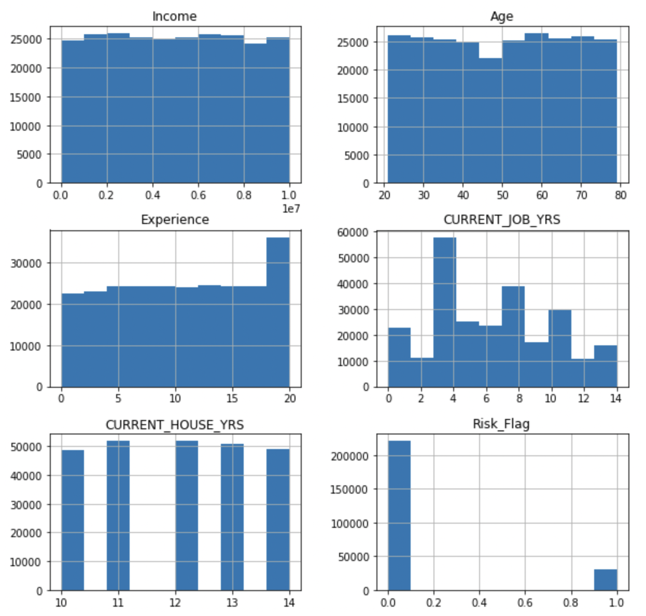
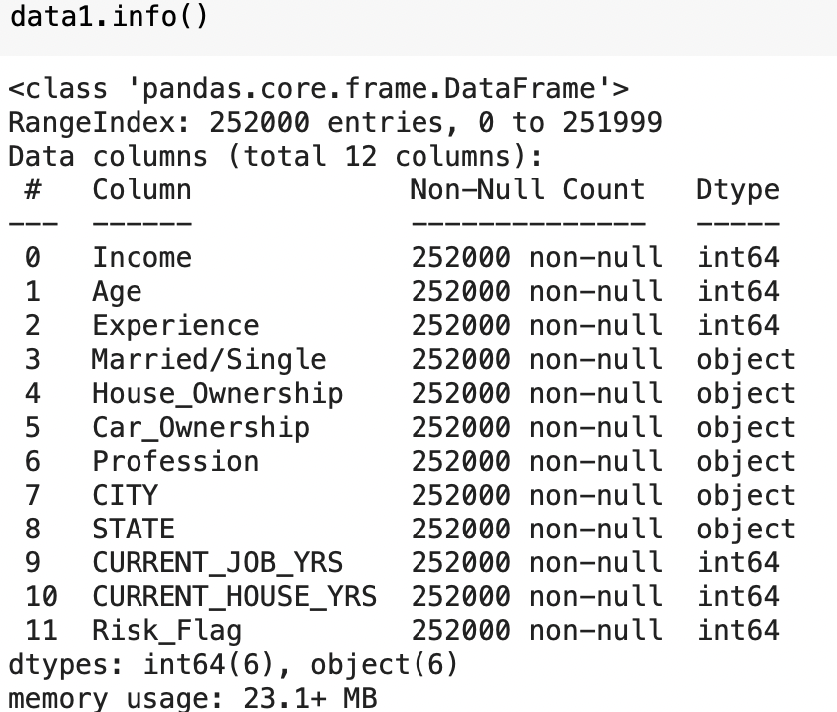
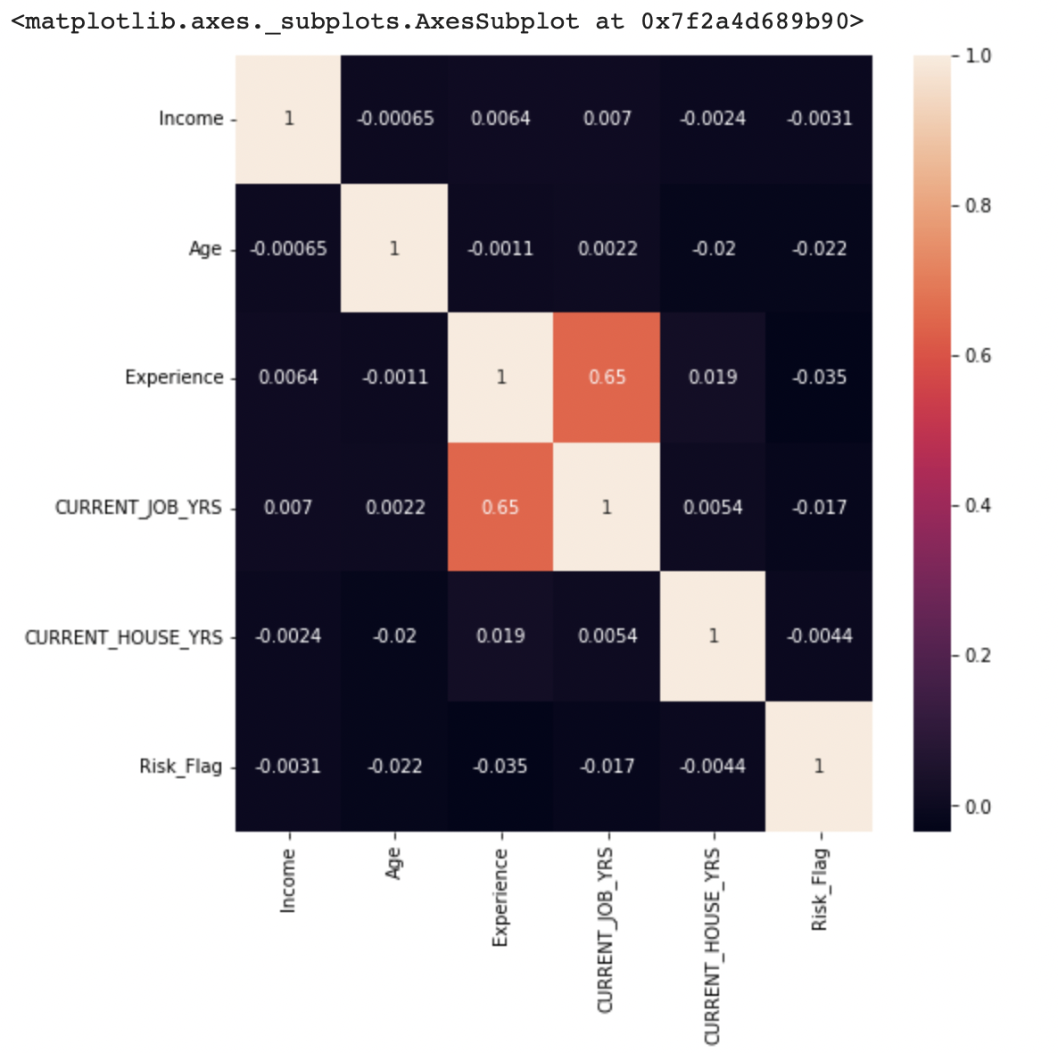
Exploratory Data Analysis
Notes:
Check the type of each variable, profession, city, and state were dropped because of cardinality(there are many terms within) so we drop these variables. Due to high correlated relationship between current job year and education, we decided to drop one of them.
We draw the histograms of those numerical variables, we did not see any significant variables expect the Risk_Flag.

Slide 4
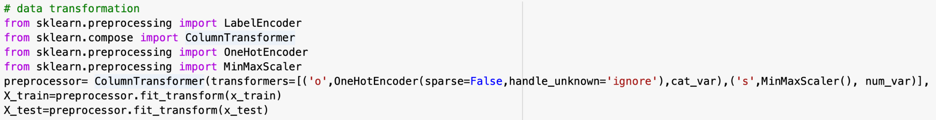
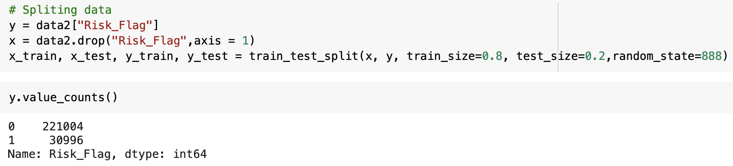
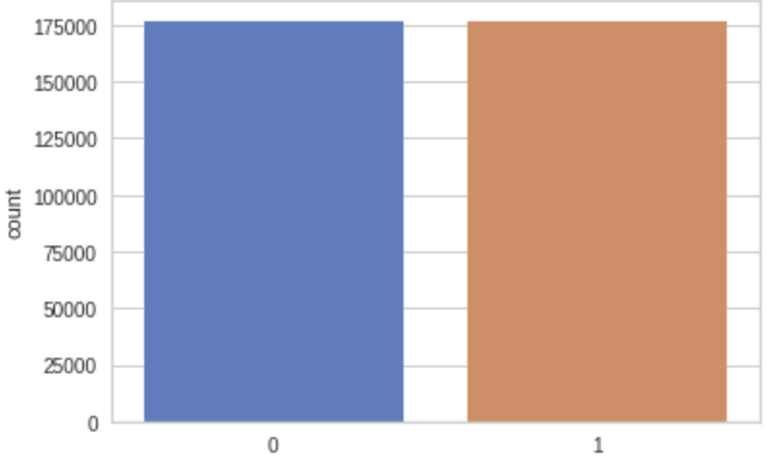
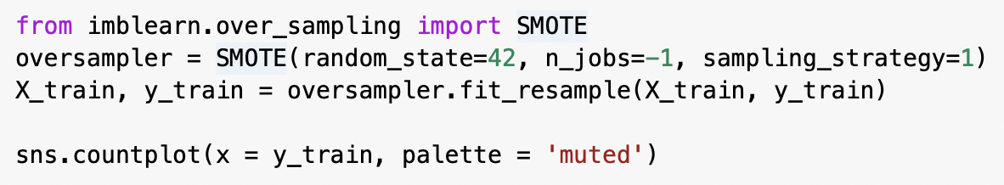
Preprocessing Data
Split the data:
Testing 20%
Training 80%
Oversampling
Using SMOTE for oversampling issues
Notes:
For those categorical variables, we use one-hot encoder to change the types to integers.

Slide 5
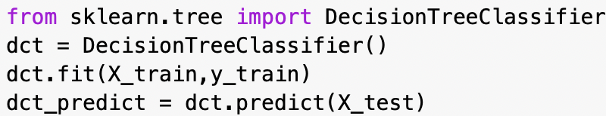
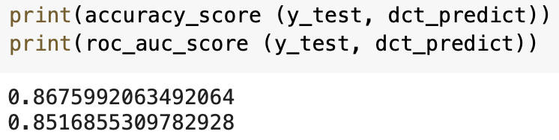
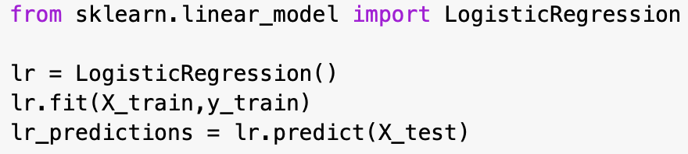
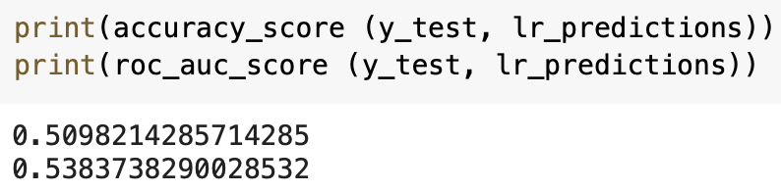
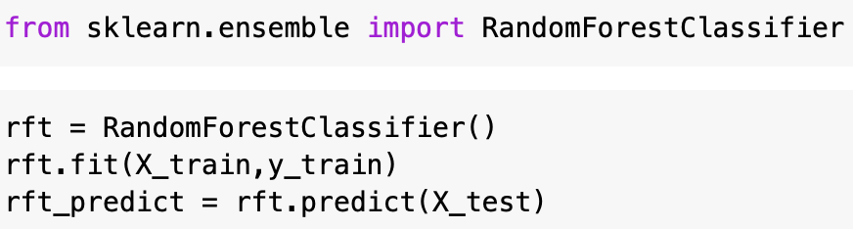
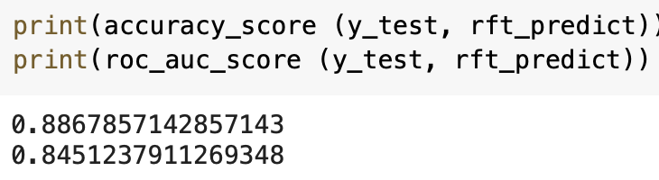
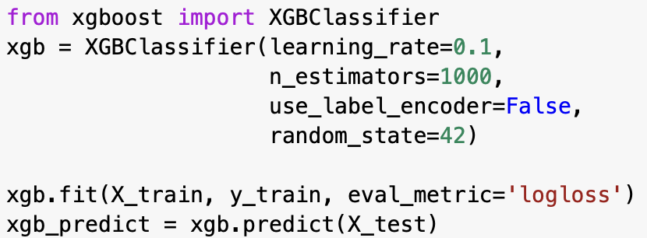
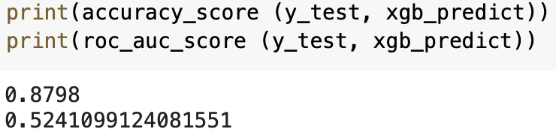
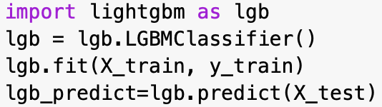
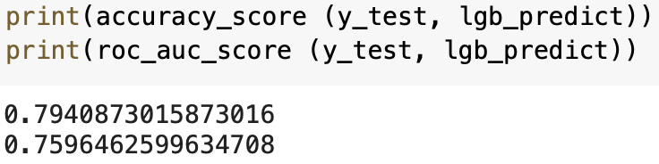
Model Selection and Evaluation of Performance
 | Decision Tree
 | Logistic Regression
 | Random Forest
 | XGB Classifer
 | LightGBM Classifier

Slide 6
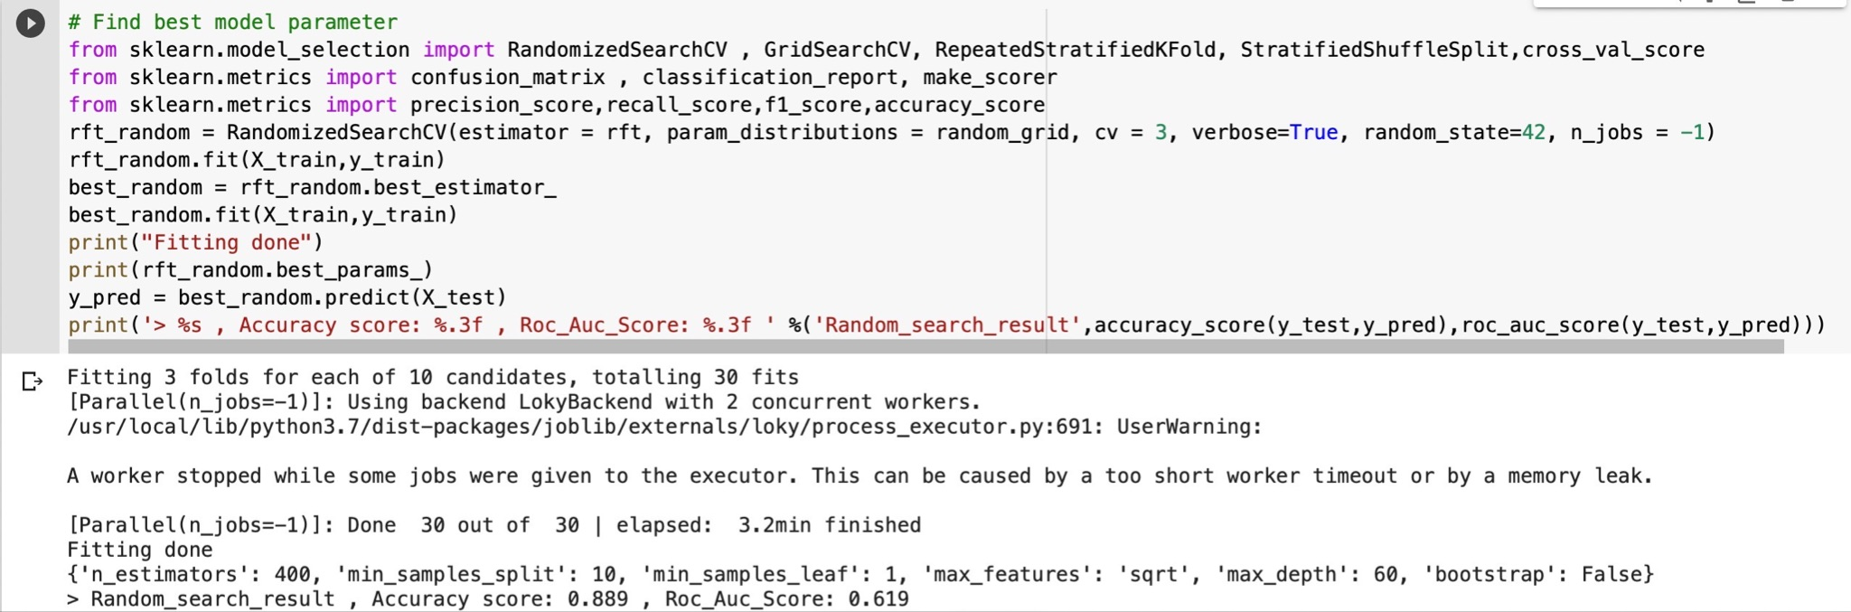
Our Best Model - RandomForestClassifer
We use Hyperparameter by conducting RandomSearchCV with 3 folds and find the best model parameter
Notes:
We use Hyperparameter by conducting RandomSearchCV with 3 folds and find the best model parameter then we fit our best parameters into our final model.

Slide 7
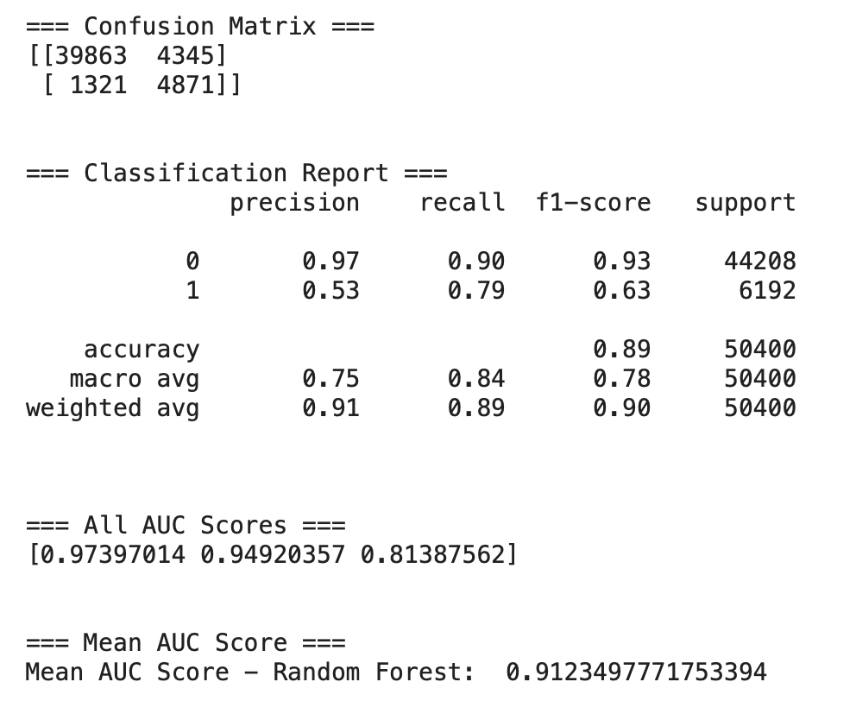
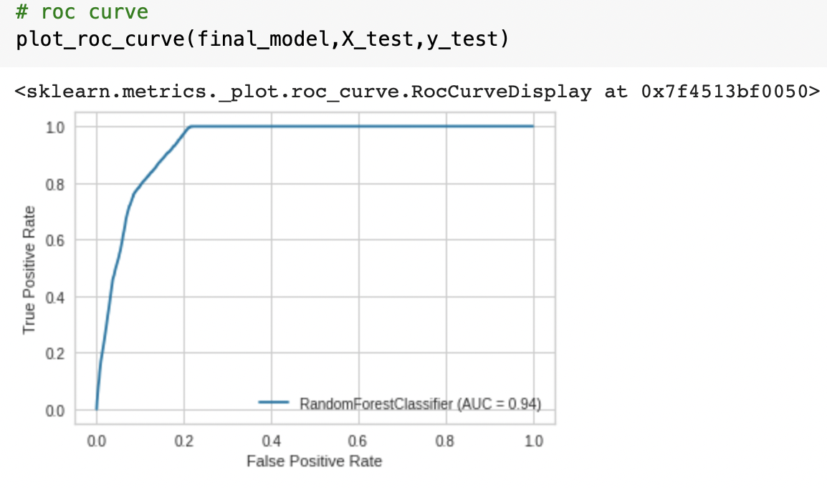
RandomForestClassifer Classification Report
Notes:
89% customers were correctly predicted. - Accuracy
Overall, we have great numbers for predicting non-default customers with a precision score and recall score over 90%.
However, this model does not predict well for those default customers since the precision score is 53%. Therefore, we need further investigation.

Slide 8
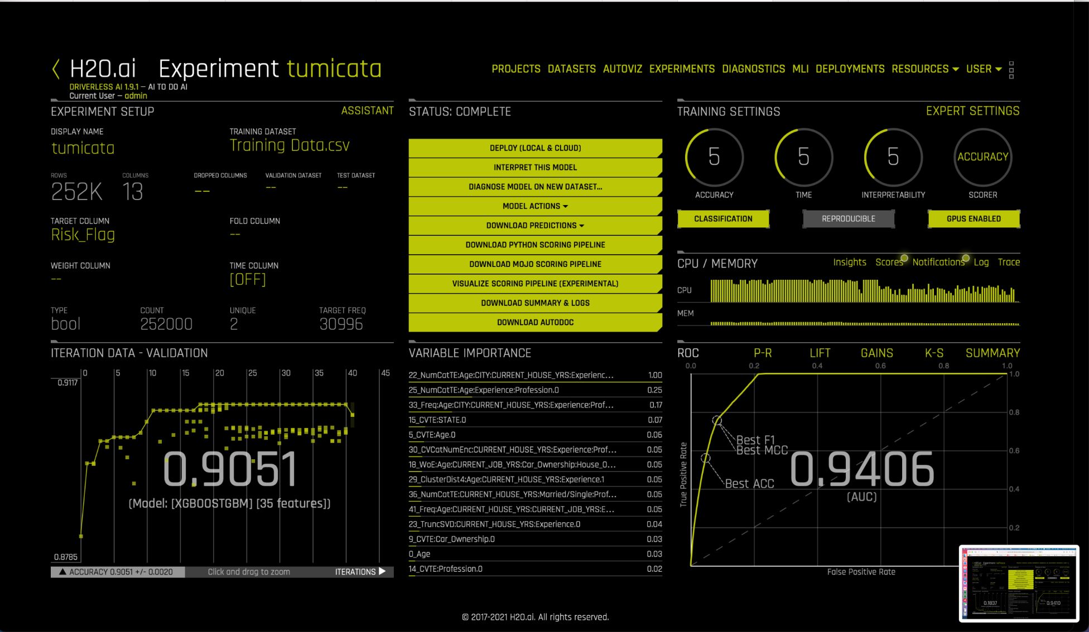
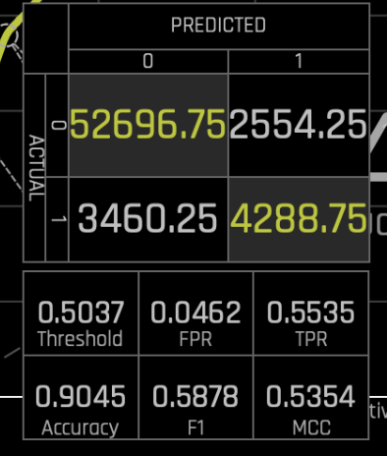
Driverless AI - Accuracy - XGB
Notes:
Next, we use Driverless AI to test. We find that XGBoost is our best classifier with an AUC score 0.9406, accuracy score 0.9045. Previously, our best model is RandomForestClassifer with an accuracy score 89%, AUC score 0.94. They are quite similar so we suggest to use XGBoost with the most suitable parameters to test the dataset again.

Slide 9
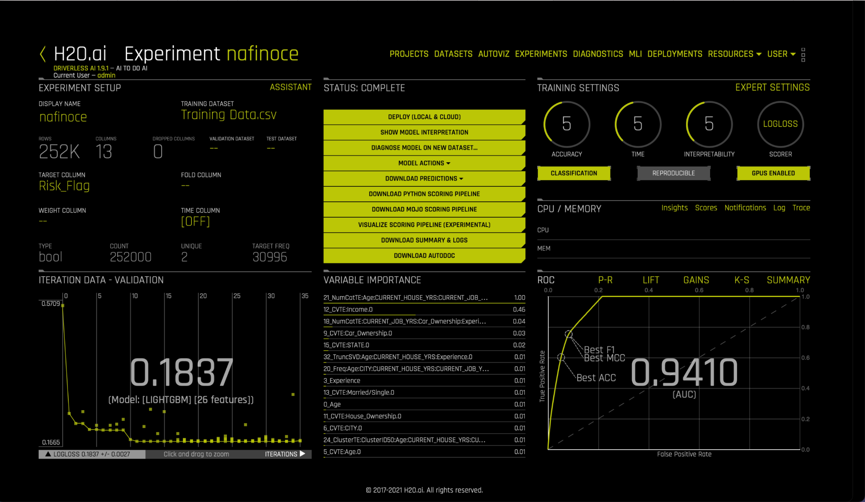
Driverless AI - Log Loss - LightGBM
Notes:
When we change the metric to log loss, the best one changes to the LightGBM. (the lower log loss, the better)

Slide 10
Lessons Learned
Different metrics give us different results.
There are many ways to find the best model. However, we need to consider time, cost, dataset etc., to find the best one in the real case.
Accuracy is not the only metric to choose the best model. It depends on the objective we made.
Notes:
For example, we choose the RandomForestClassifer as our best model because it has the highest Accuracy and AUC score compared to other four models. However if our target is to find those potential defualters, our RandomForestClassifer does not get higher precision score.

